Slide 1

Cloud
Design Patterns
Sharath Sahadevan,
@sharath_sahadev,
ssahadevan@pivotal.io
Feb 2016
Notes:
Innovation driven by software…you need to deliver and iterate faster

Slide 2
Agenda
Introduction
Overview of Cloud design patterns
Demo
Q/A

Slide 3
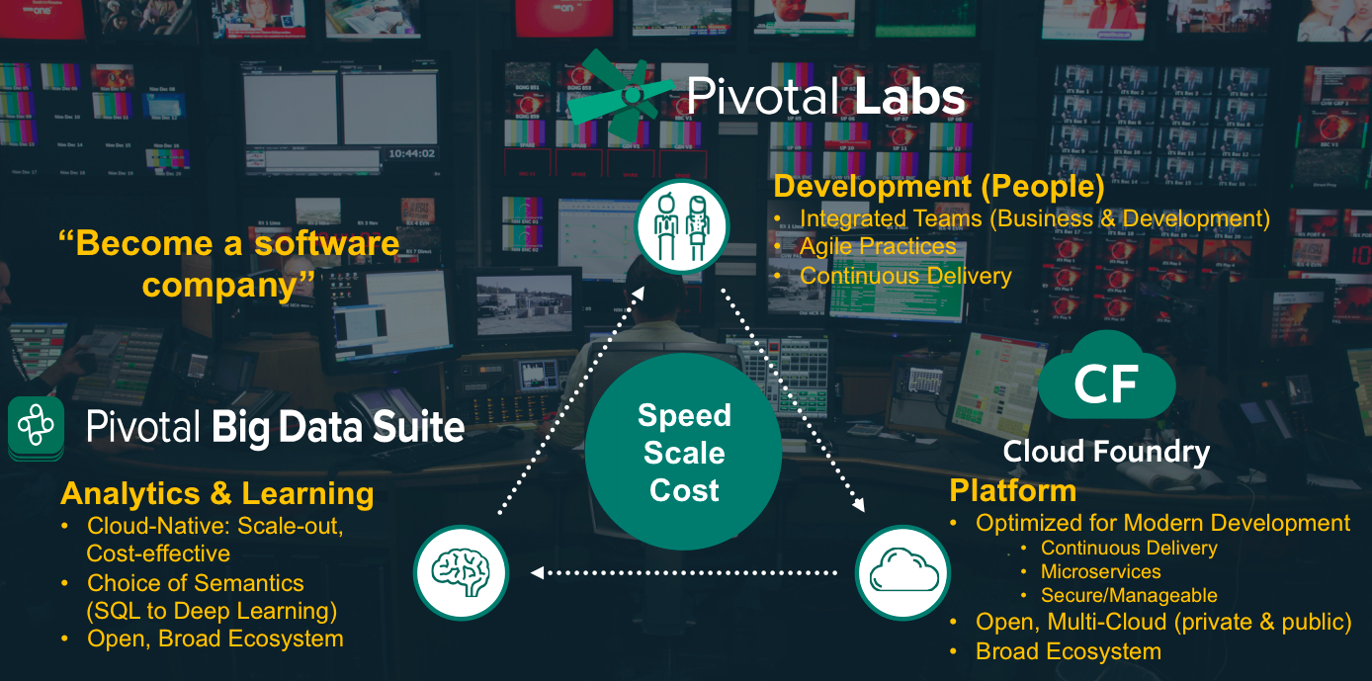
About Pivotal

Slide 4

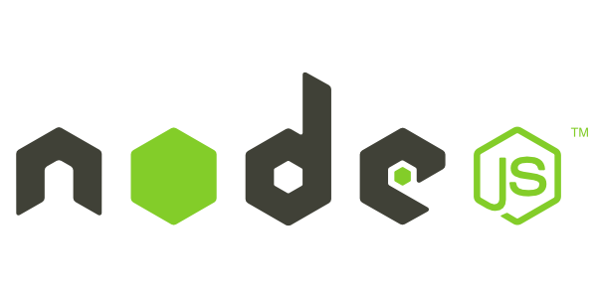

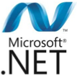


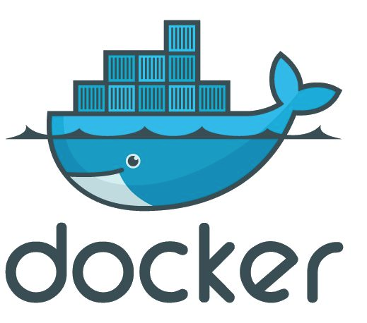

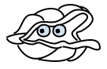
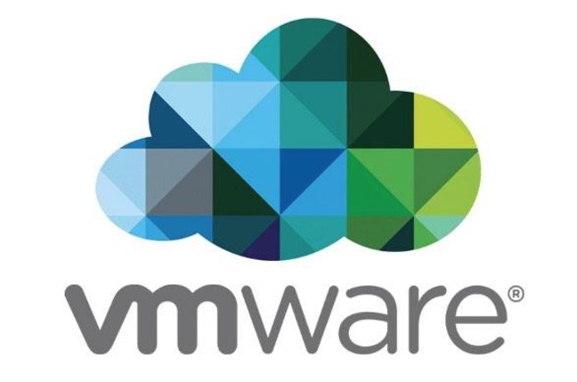
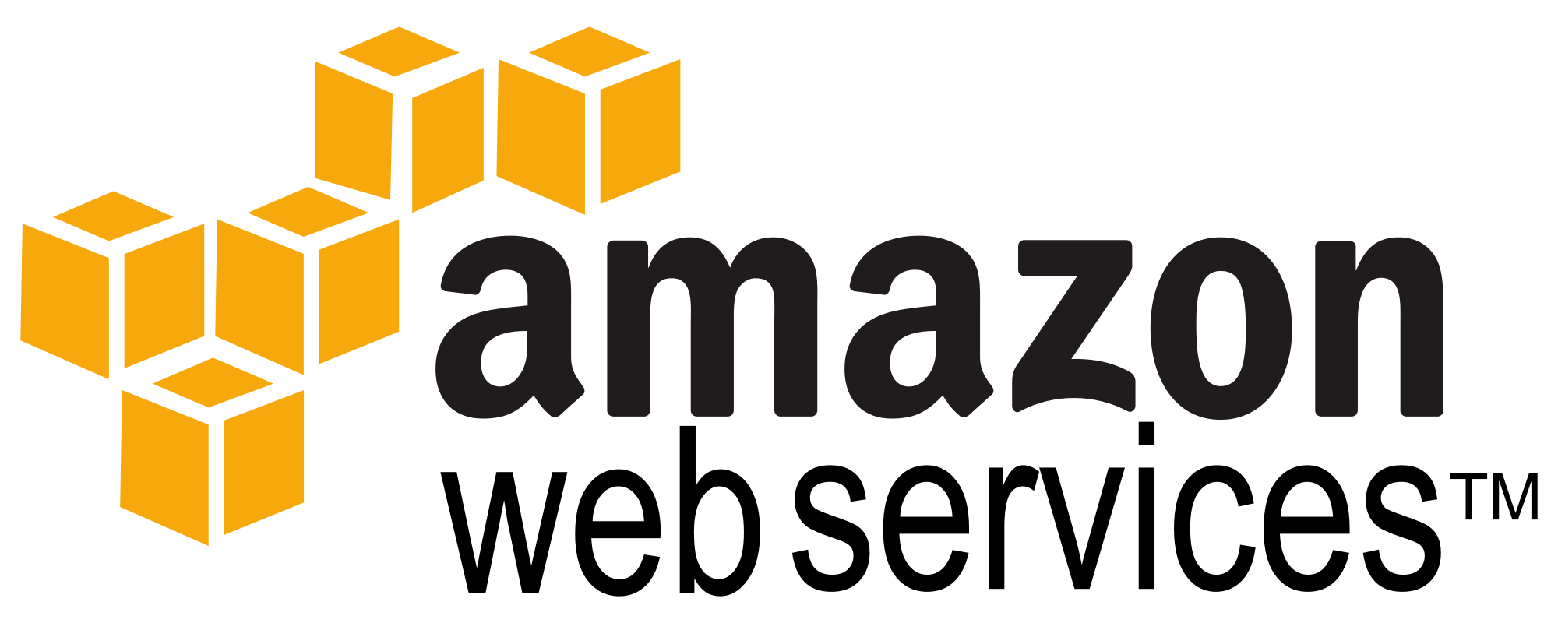

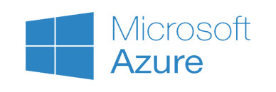
Culture
Structured PaaS Framework
Tools
Application Framework
Spring Boot
Dev
Contract: Cloud Native App
Runtime Platform
Dev
IT Ops
Contract: BOSH Release
Infrastructure Automation
IT Ops
BOSH
Contract: Cloud Provider Interface
Infrastructure
IT Ops

Slide 5
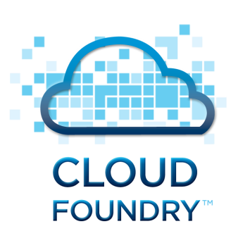
Cloud Foundry is…
The open source application platform-as-a-service.
Supported by dozens of major organizations
Language and framework agnostic
Manages both VMs and containers
Orchestrates both applications and data services
Abstracts Infrastructure
Founded and commercialized by Pivotal, Inc.

Slide 6
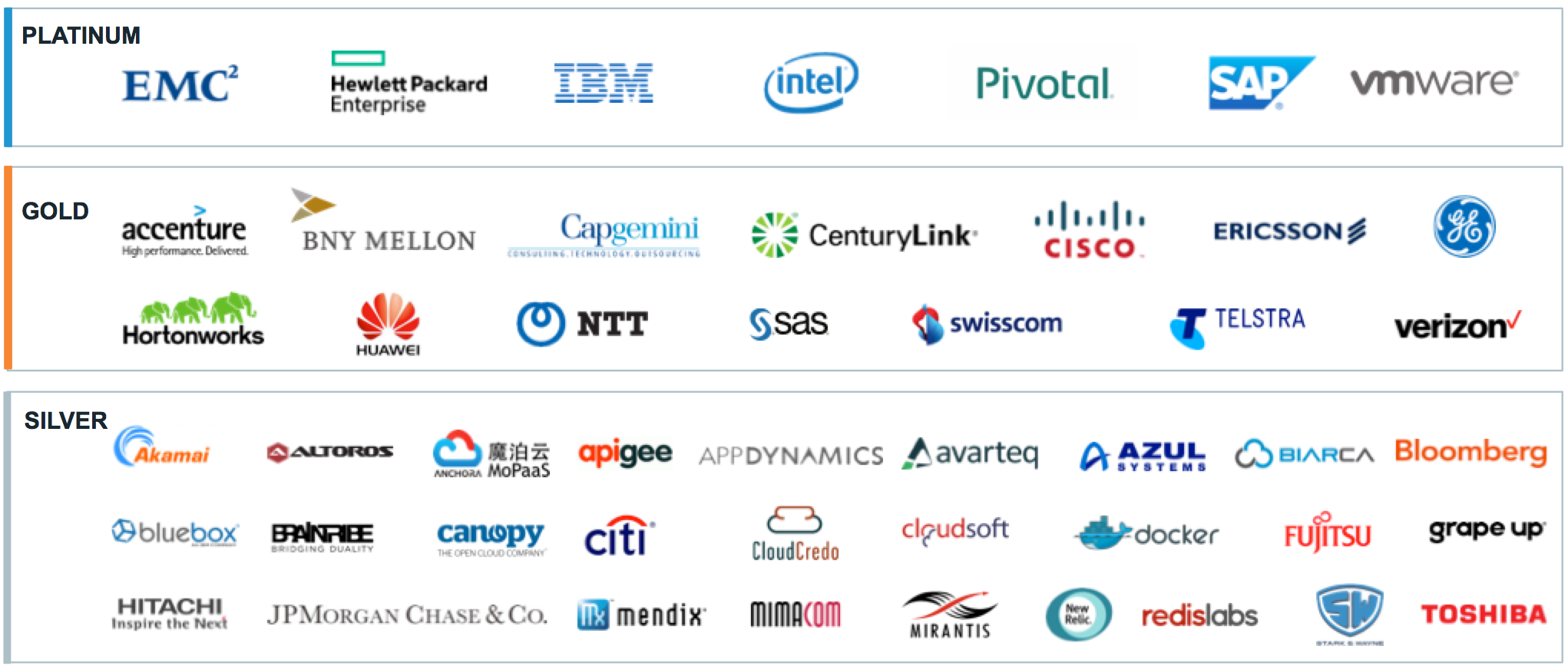
The Cloud Foundry Foundation: An Open Industry Standard
2013
Transferred from VMWare to Pivotal
2014
1 trillion dollars in market cap supporting the project
2015
Governance passed to Cloud Foundry Foundation

Slide 7
CF Meetup in St Louis
To Learn more about Cloud Foundry visit the CF Meetup
Next meetup is on Feb 16. Presentation by Kenny Bastani.
Spring Developer advocate and author.

Slide 8
Design Patterns
Microservices
Abstraction
Twelve Factor
Service Registry
Config Server
Circuit Breaker

Slide 9
Monolithic Architecture
Tomcat
Store Front UI
Browser
Apache
Inventory Service
Accounting Service
DB

Slide 10
DEFINE: Microservice
If every service has to be updated in concert, it’s not loosely coupled!
Loosely coupled service oriented architecture with bounded contexts
If you have to know about surrounding services you don’t have a bounded context.

Slide 11
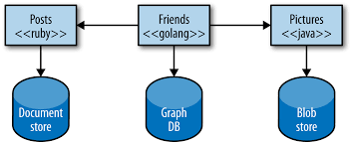
Microservices

Slide 12
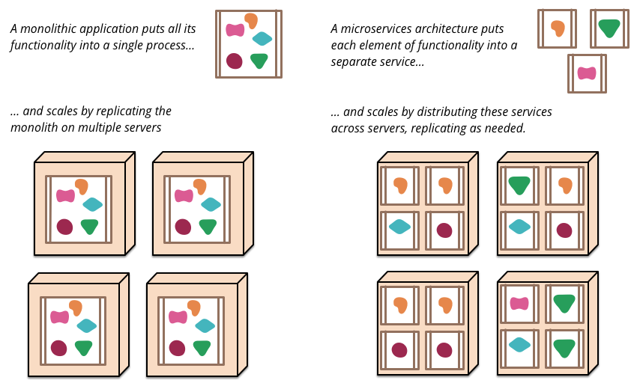
Scaling Monolith Vs Microservices

Slide 13
Enabling Continuous Delivery
Product
Mgr
UX
Dev
QA
DBA
Sys
Admin
Net
Admin
Storage
Admin
Self
Service
API
BUSINESS CAPABILITY TEAMS
USING MICROSERVICES
PLATFORM OPERATIONS TEAM
Adapted from: http://www.slideshare.net/adriancockcroft/goto-berlin

Slide 14
Abstraction
Traditional
IaaS
Cloud Native
Automation
Application
You
Manage
Application
Application
Data
Data
Agility and Cost Savings
Data
Runtime
You Manage
Runtime
Runtime
Middleware
Middleware
You Manage
Middleware
Container
O/S
O/S
O/S
Pivotal Cloud Foundry
Virtualization
Virtualization
Virtualization
IaaS Provider
Storage
Servers
Servers
Servers
Networking
Networking
Networking
Abstraction

Slide 15
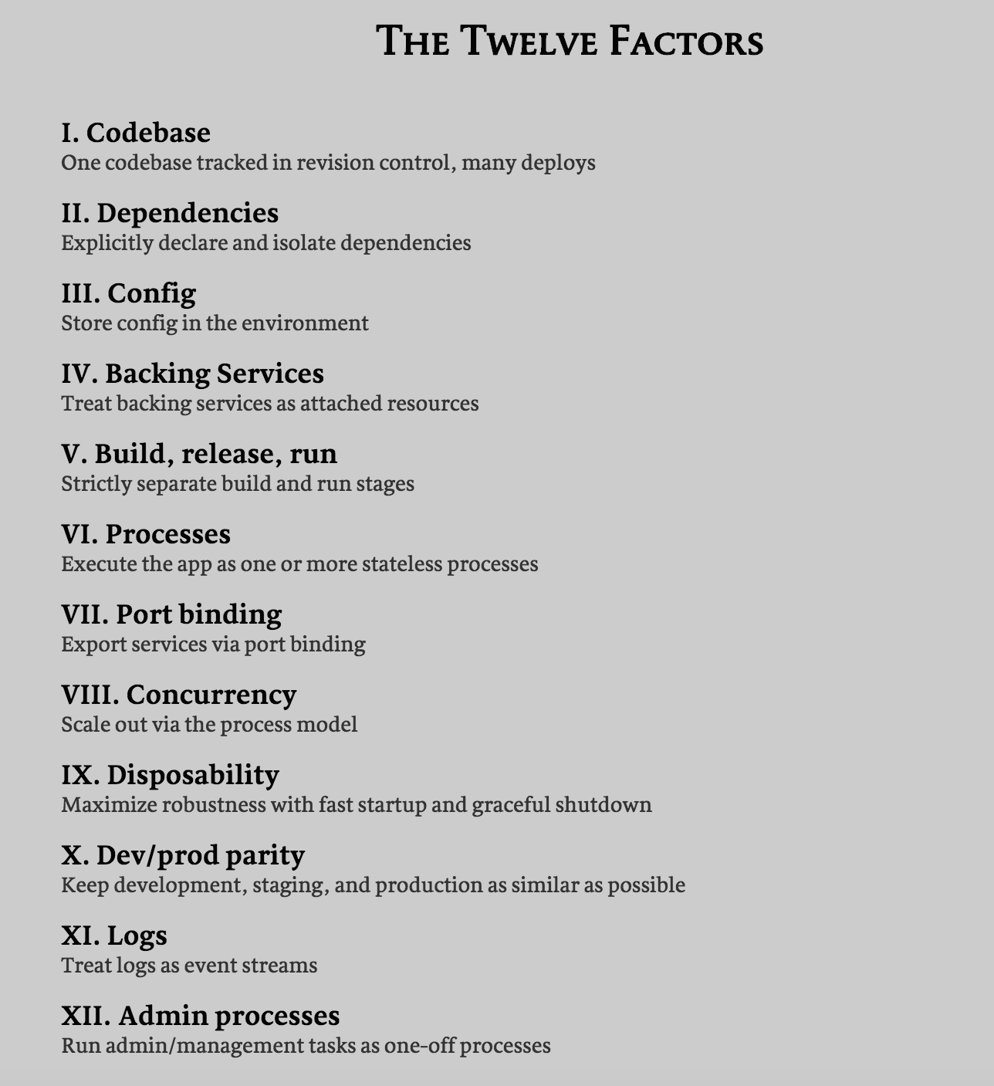
Twelve Factor Apps – 12factor.net

Slide 16
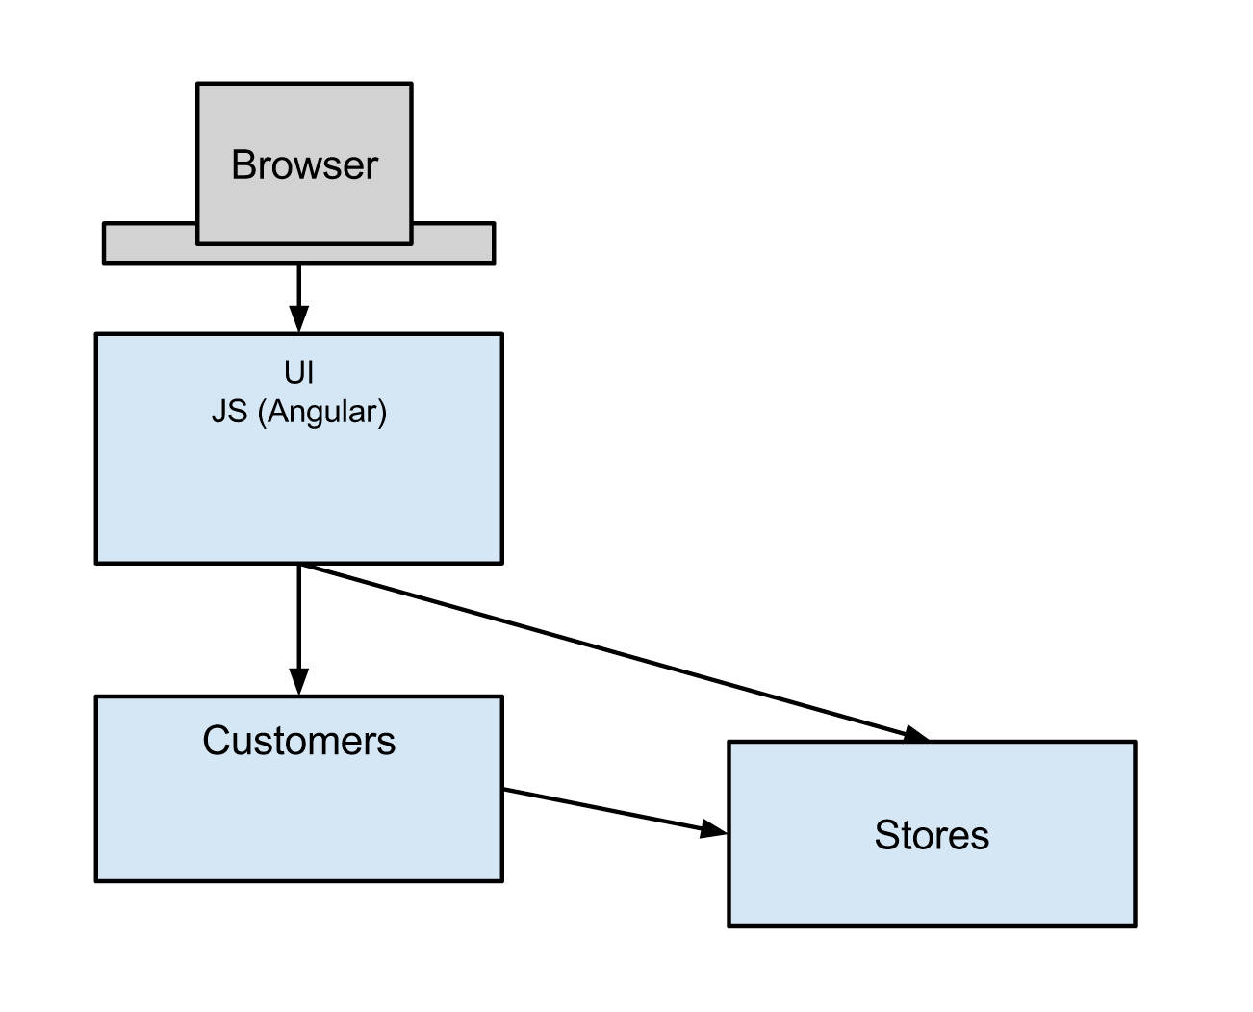
Example Distributed System:

Slide 17
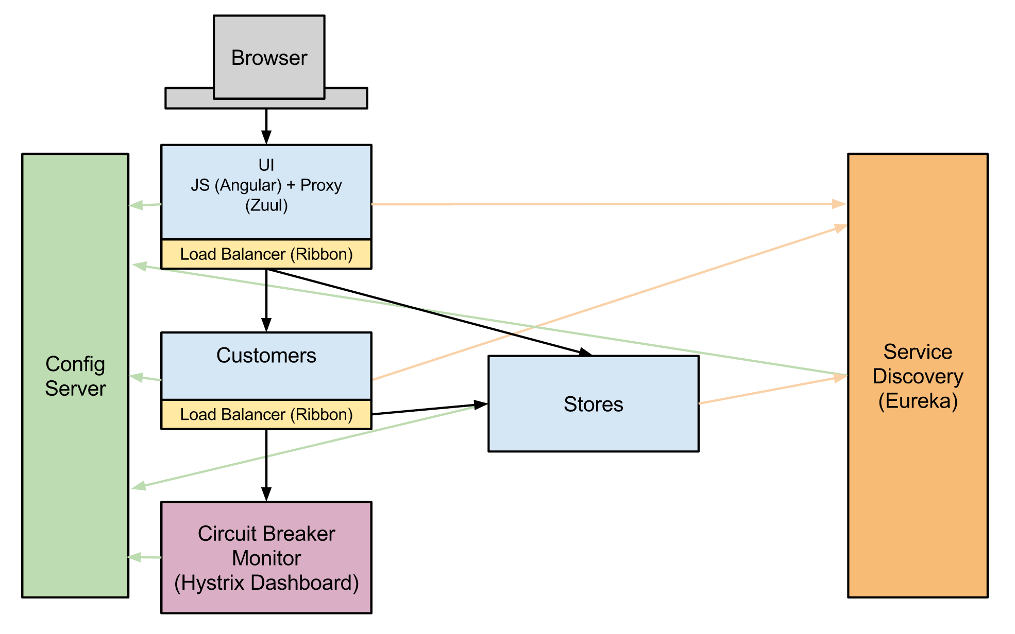
Example: Spring Cloud + Netflix OSS

Slide 18
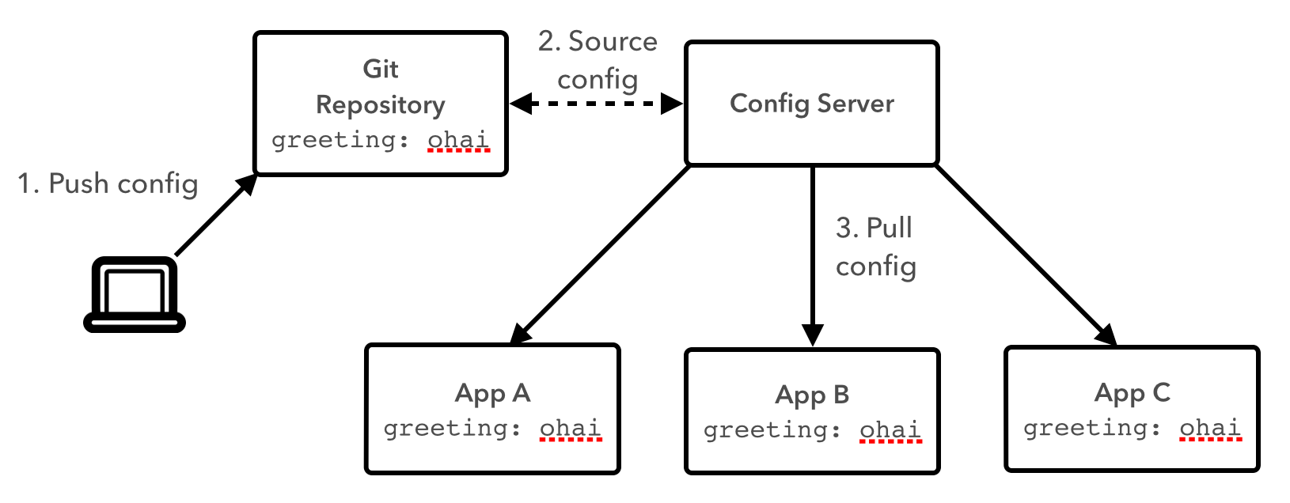
Config Server

Slide 19
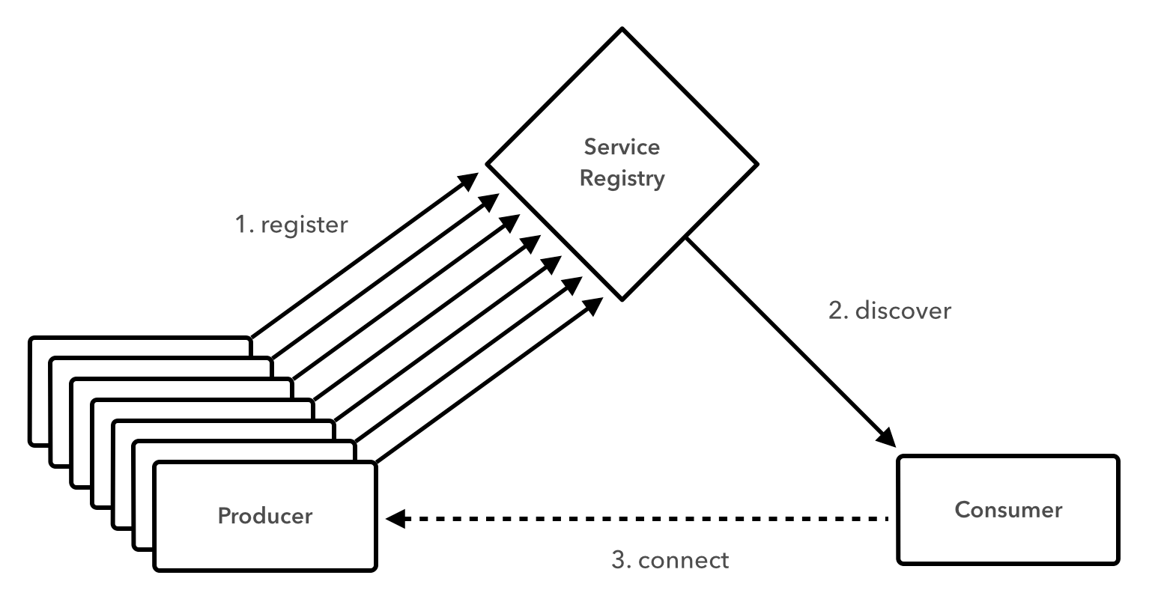
Service Registration/Discovery

Slide 20
Service Registration/Discovery
@SpringBootApplication
@EnableCircuitBreaker
@EnableDiscoveryClient
public class CustomerApp extends RepositoryRestMvcConfiguration {
@Override
protected void configureRepositoryRestConfiguration(RepositoryRestConfiguration config) {
config.exposeIdsFor(Customer.class);
}
public static void main(String[] args) {
SpringApplication.run(CustomerApp.class, args);
}
}

Slide 21
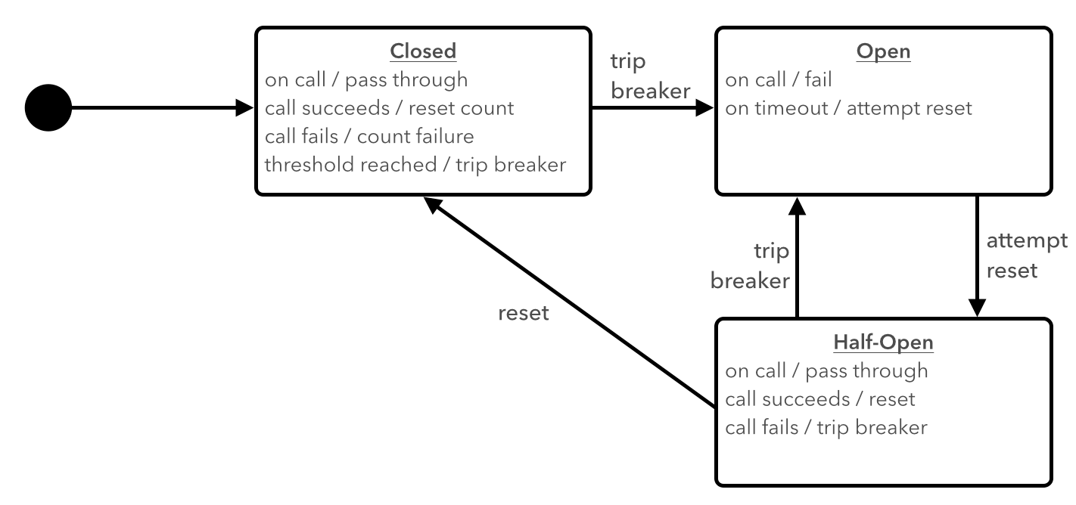
Fault Tolerance – Circuit Breakers

Slide 22
Fault Tolerance – Circuit Breakers
@SpringBootApplication
@EnableCircuitBreaker
@EnableDiscoveryClient
public class CustomerApp extends RepositoryRestMvcConfiguration {
@Override
protected void configureRepositoryRestConfiguration(RepositoryRestConfiguration config) {
config.exposeIdsFor(Customer.class);
}
public static void main(String[] args) {
SpringApplication.run(CustomerApp.class, args);
}
}

Slide 23
Fallback Method
@HystrixCommand(fallbackMethod = "sayHelloFallback")
public String sayHello(String toWho) {
try{
return restTemplate.getForObject("https://hello-world-server/hello?name={name}", String.class, toWho);
} catch (Exception e) {
e.printStackTrace();
throw e;
}
}
public String sayHelloFallback(String toWho) {
return String.format("Error, can't say hello to %s", toWho);
}

Slide 24
Resources Link to video of Spring Cloud Service demo – Sharath Sahadevan Spring boot code is available at: https://github.com/ssahadevan-pivotal/SpringCloudWorkshop/tree/master/session_05/lab_08/hello-world Microservices – Martin Fowler Getting started with Spring Cloud – Josh Long Building Microservices – Sam Newman Spring Cloud project at Spring.io Migrating to Cloud Native Architectures – Matt Stine run.pivotal.io - Sign up for a free account and learn more about Pivotal Cloud Foundry STL CF Meetup – Monthly meetings in ST Louis. Next meeting on Tue Feb 16, 2016

Slide 25
Demo’s

Slide 26


Let’s build something MEANINGFUL
Notes:
From Silicon Valley…

Slide 27
Thank you
Notes:
From Silicon Valley…

